Slide 1
Price Analysis on Hotel Accommodation
By
Valluri Naveen

Slide 2
Problem Statement
Finding right place for comfortable stay within the budget
Objective
Price Analysis on OYO Hotels based on Cities, Reviews and Star ratings

Slide 3








DATA EXTRACTION
Website – OYO
Website URL - https://www.oyorooms.com/
TOOLS(LIBRARIES) USED
Requests
BeautifulSoup
Pandas
Numpy
RegularExpression
Matplotlib
Seaborn
Plotly

Slide 4
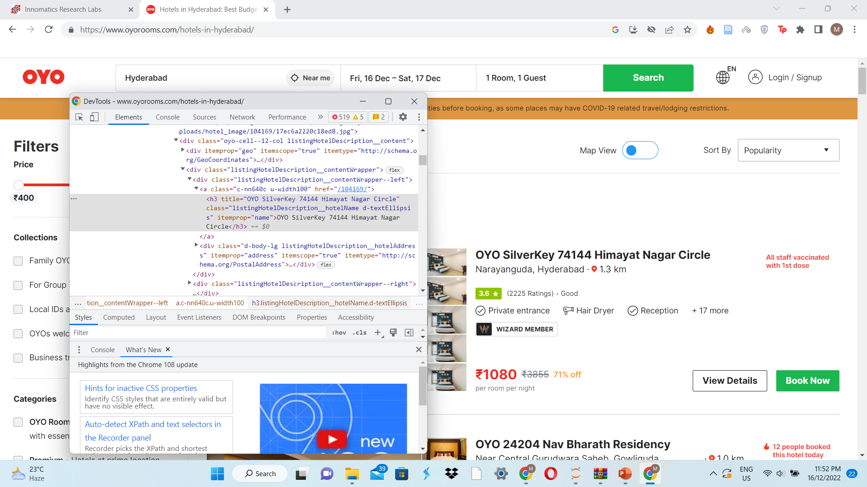
WEB SCRAPING

Slide 5
DataFrame Creation
Chosen to extract data of four different cities from OYO website
Different cities and page numbers.
URL=f” https://www.oyorooms.com/page{i}”
Getting URL from website through the process requests.get() ,Checking the Status Code and setting the Status code
Beautifying the data by using BeautifulSoup libraries.
Loading HTML of the website using inspect
Soup.findall()
Saving data in one Container
By using container picked the required data
By using regex Collected data is Cleaned and appended to Empty List
Empty lists – labels of our columns
Check length of columns
Dictionary creation
Data Frame creation

Slide 6
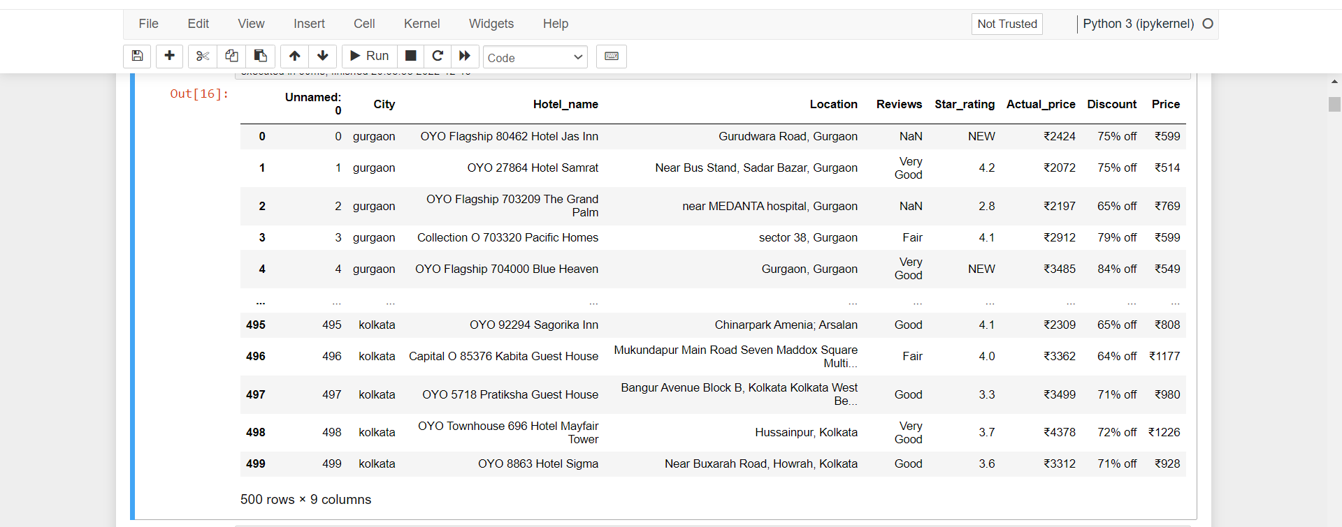
Raw Data Frame

Slide 7
Data Cleaning
Handling the missing values.
Filling the missing values with the Mean Values for the Numerical Data.
Filling the missing values with the mode Values for Categorical Data.
Replace missing values.
Converting the Values to ‘int’ and ‘Float’.
Dropping the null values .

Slide 8
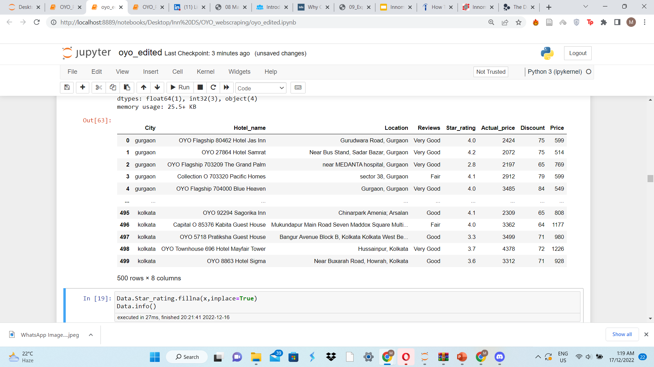
Cleaned Dataset

Slide 9
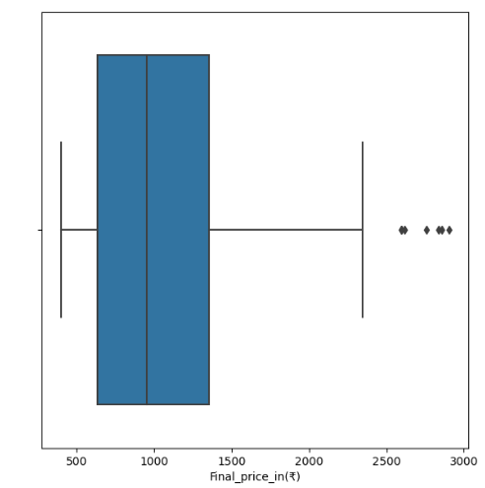
Outliers
Checking the outliers
Treating the outliers
Insights :
• From 600 to 1400 has a Good price Values
•From 2500 to 2800 are Outliers

Slide 10
VISUALIZATION
Univariate Analysis
Bivariate Analysis
Multi-variate Analysis

Slide 11
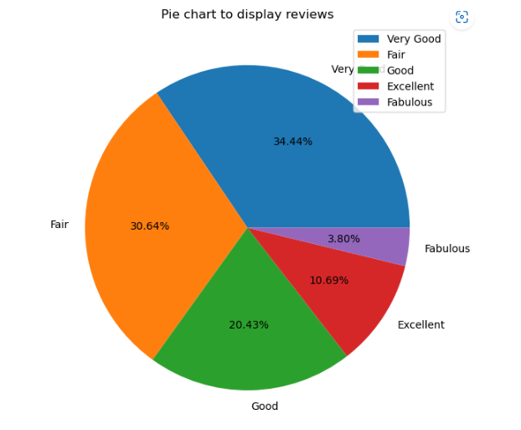
Univariate Analysis
Reviews
Insights:
• The pie-chart clearly shows that largest proportion of customers reviewed OYO hotels as 'Very Good’, while the review ‘Fablous' was given by least number of customers. The review ‘Fair' was also provided by decent percentage of people.

Slide 12
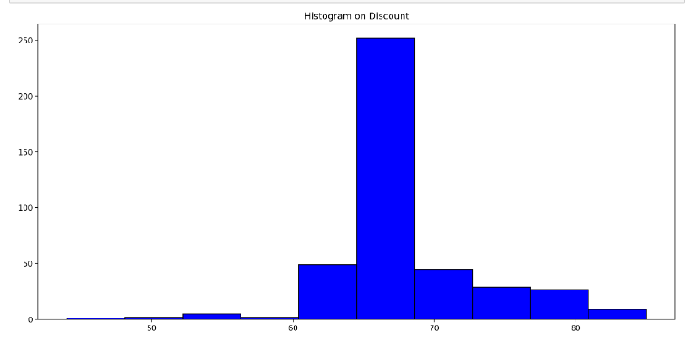
Discounts By Hotels
Insights :
The Histogram above was plotted based on the Discounts was given By Hotels to customers
Most of the hotels are giving discount between 60% to 70%

Slide 13
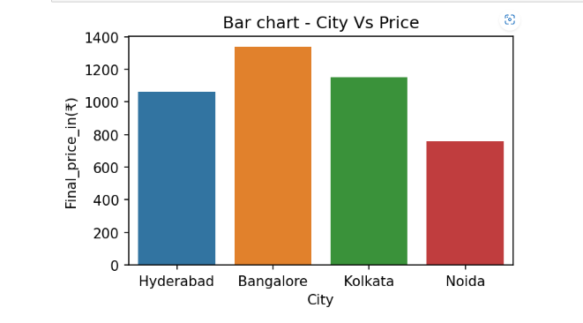
Bivariate Analysis
Insights
Evidently, the OYO hotels in Bangalore city are quite expensive in comparison to the remaining four cities.
Noida offers relatively cheaper hotels.
Only slight variation is observed in the prices of Kolkata and Hyderabad.
City-Final Price

Slide 14
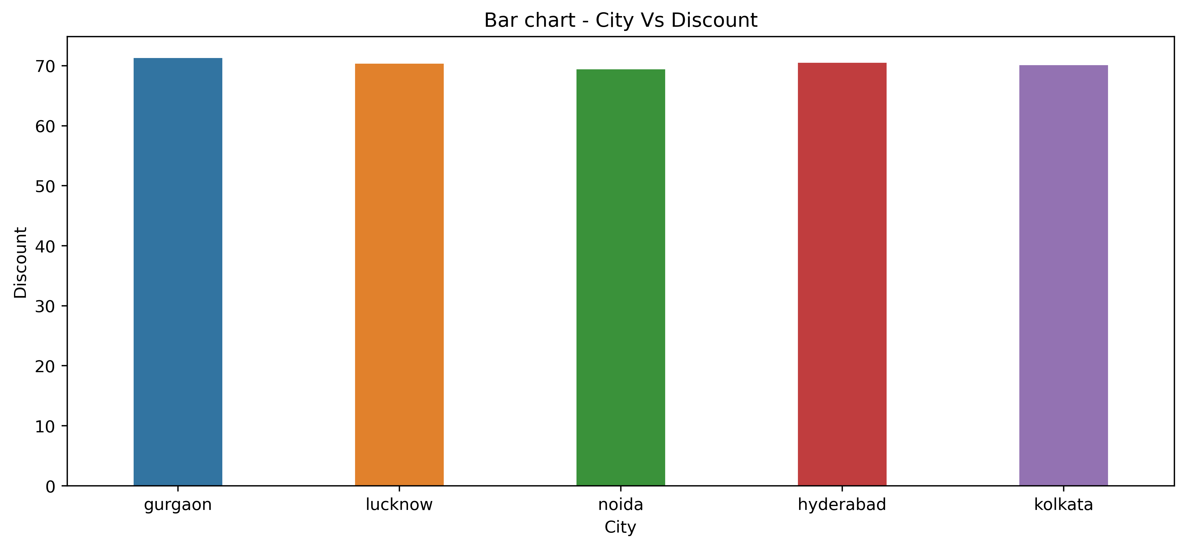
City-Discount
Insights :
There is no visible difference in the discounts offered by hotels at various cities.

Slide 15
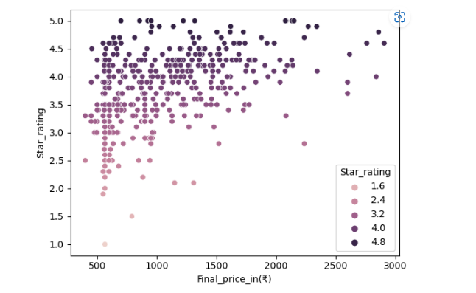
Final Price-Star rating
Insights :
More hotels lie in range Rs.500 – Rs.1500. Star rating ranges from 3.0-4.5.
The above scatter plot helps us to understand that there is no structured relationship between price and star rating

Slide 16
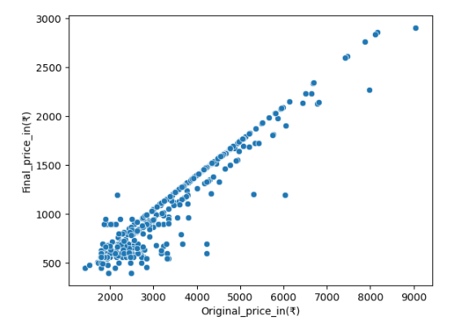
Original Price-Final Price
Insights :
There is a clear positive correlation between Original price and Price.
However, there are a few deviations due to the discount factor

Slide 17
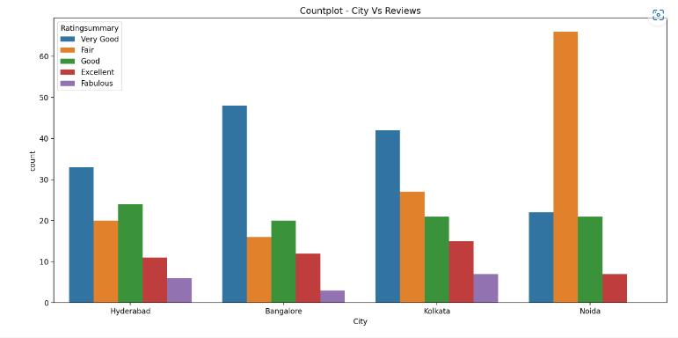
City-Reviews
Insights :
Kolkata has top in Reviews
Noida has least in Reviews

Slide 18
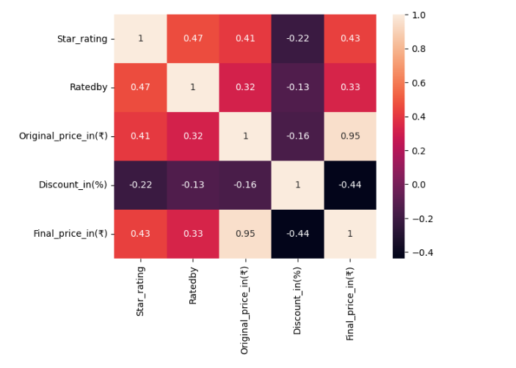
Multi-variate Analysis
Insights
Visible positive correlation between Final Price and Original price
Negative correlation between discount and Rated by

Slide 19
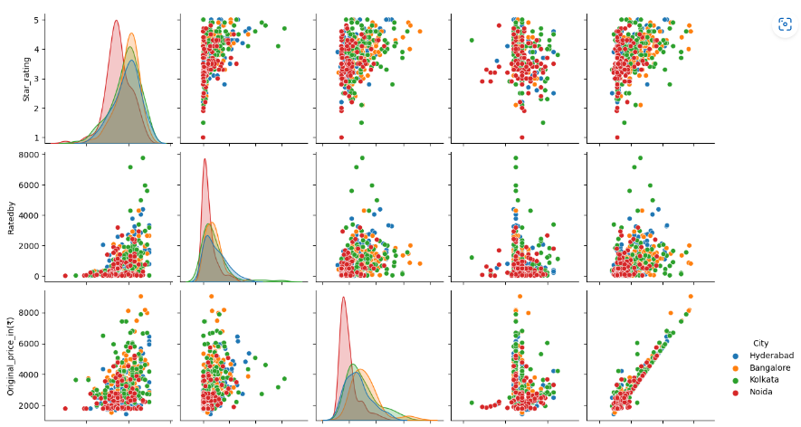
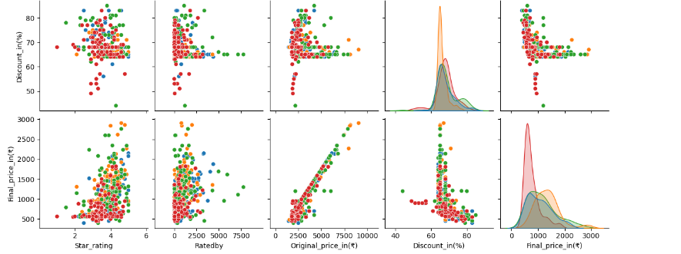
Pairplot:
To plot multiple pairwise bivariate distributions in a dataset, you can use the .pairplot() function.
The diagonal plots are the univariate plots, and this displays the relationship for the (n, 2) combination of variables in a DataFrame as a matrix of plots.
Insights :
From the Pairplot we can describe completely about Final_price,Discount,Original price,Ratedby and Star Rating
With Respect to City.

Slide 20
Challenges Faced
• Due to Dynamic Website While changing the Dates website URL is
Changed.

Slide 21
CONCLUSION
OYO Hotel prices are highest in Bangalore city.
Hotels in Noida city are cheaper when compared, but display maximum “Fair” reviews by the customers.
OYO Hotels offer almost same proportions of discounts across different cities.
Original price (Price before discount) is linearly varying with Price (Discounted price). However, few deviations are visible due to varying discounts.
Hotel prices are totally independent of star ratings.
Overall, OYO reviews and ratings prove the firm’s ability to satisfy the customers.

Slide 22

THANK YOU

